Slide 1
TelAPI Classroom
Learning how to build awesome applications in Telecom
Using Python

Slide 2
Our Goals
Provide a basic overview of Python
Use python to create a live call
Create a callback for the live call - to speak to the caller

Slide 3

What is Python?
“Python is a general-purpose, high-level programming language whose design philosophy emphasizes code readability” - Wikipedia
Notes:
http://en.wikipedia.org/wiki/Python_(programming_language)

Slide 4
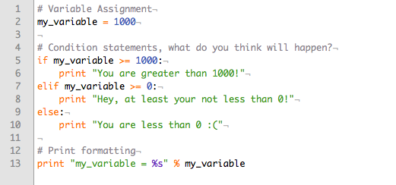
Python Basics

Slide 5
Python Lists (part 1)
Python lists are exactly what they seem to be, a listing of values. Python lists are commonly used as a container for a listing of important values, such as names, phone numbers, email addresses, etc.
We won’t be needing a python list for this unit, but they’re still something you should learn!

Slide 6
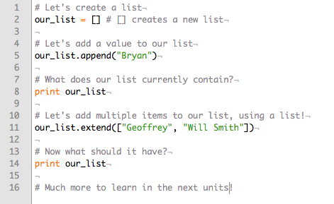
Python Lists (part 2)

Slide 7
Python Dictionaries (part 1)
Python dictionaries are “mappings” of keys and values. You can think of them as lockboxes, where a certain key will open a certain vault, revealing the contents of that vault.
We will be using dictionaries to prepare data to be sent over HTTP to the TelAPI server.

Slide 8
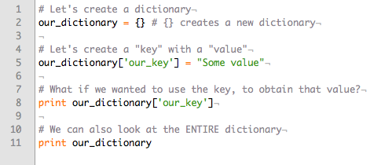
Python Dictionaries (part 2)

Slide 9
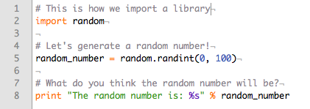
Python Imports

Slide 10
Let’s Catch Up
What have we learned?
Basic Syntax
List Creation
Dictionary Creation
Python Imports
What’s coming next?
Viewing all concepts put to work to place a call!
A brief summary of inboundXML
Preparation for the next unit’s content

Slide 11
Questions So Far?
I’d like to give anyone with a question or a comment an opportunity to submit their thoughts!

Slide 12
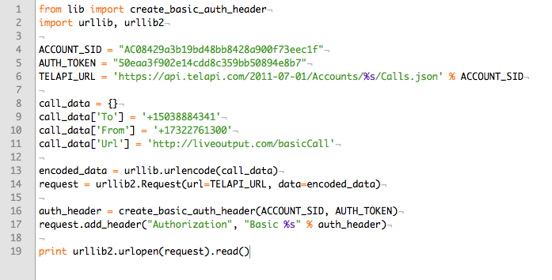
Place a Call with 19 lines of code!

Slide 13
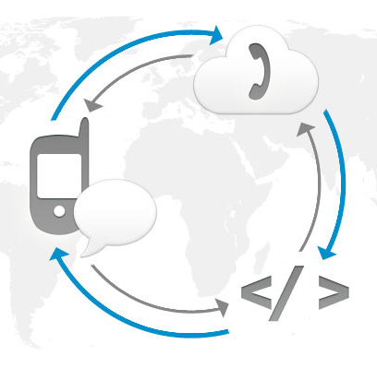
What Happened?
Let’s look into what happened once line 19 of the previous slide was executed.
This will be a crash course as to the mechanics of TelAPI!

Slide 14
What urllib2 Really Did
When you saw urllib2.urlopen, that actually POSTED everything you prepared in the request to TelAPI
TelAPI parsed the inbound data, and created a call to the party specified by the “To” key, from the phone number identified in the “From” key
TelAPI completed the request by acknowledging the creation of the call by responding with a JSON version of the call object TelAPI created.

Slide 15
So What Happens When I Answer?
As a continuation of the previous explanation, TelAPI resorts to the “Url” key in the request, to determine where to look for inboundXML.
In TelAPI language, inboundXML identifies what TelAPI should do for the person sitting on the listening end of the phone.
Now we need to know what inboundXML is, and how to use if for the good of our civilization!

Slide 16
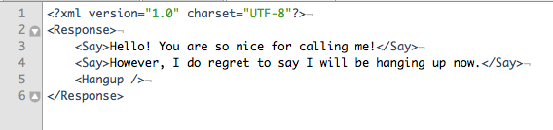
inboundXML Example
This working example of inboundXML, says two things to the user and
immediately hangs up afterwards. How rude of the lonely IVR!

